Slide 1
Course Directive / Introduction

Slide 2
Aim
Officially:
To give an understanding of the fundamentals of database management systems with an emphasis on relational systems.
To achieve that we focus on:
Database theory
Data modelling
Manipulating a database using SQL

Slide 3
Course Information
SMS Code | IN605001 | Directed Learning hours | 60
Level | 6 | Workplace or Practical Learning hours | 0
Credits | 15 | Self Directed Learning hours | 90
Prerequisites | IN505001 IN511001 | Total Learning Hours | 150
This course partially replaces IT206001 Name of other Programme: Bachelor of Information Technology (version 2)

Slide 4
Course Interruptions
If Otago Polytechnic is closed:
Check (don’t assume)
Refer to your email for alternative arrangements

Slide 5
Course content
Refer to table
This is loose and may be changed depending on our progress and any issues that develop.
Main topics
Modelling
Data Model (conceptual model)
Database Model (ERD)
DB Theory
SQL and data manipulation

Slide 6
Assessment
Item | Due Date | Weighting | Learning Outcomes
SQL Worksheet | 6th April (11:59 pm) | 10 | 3
Validation Worksheet | 29th May (11:59 pm) | 10 | 3, 4
Design | 1st May (11:59pm) | 20 | 1, 2
Build | 5th June (11:59 pm) | 20 | 1,2,3,4
Exam | 18/19th June (Class) | 40 | 1,3,4
 |  | 100

Slide 7
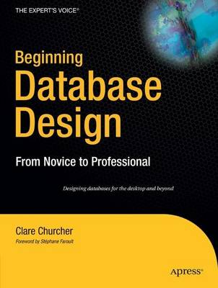

Textbook
Highly Recommended:
Required

Slide 8
Other Resources
I:\COURSES\ITP\BITY1\IN605 DB2
Maria / MariaDB for database work
Access with Putty
Should be available from home, if not SSH through Kate
Figure out how to transfer files with WinSCP or other tool
SQLLite
Google it.

Slide 9
MariaDB
MariaDB Server is one of the most popular database servers in the world. It’s made by the original developers of MySQL and guaranteed to stay open source. It is a community-developed fork of the MySQL relational database management system intended to remain free under the GNU GPL. Notable users include Wikipedia, WordPress.com and Google.

Slide 10
Any questions

